Slide 1
CRM
Template (v1)

Slide 2
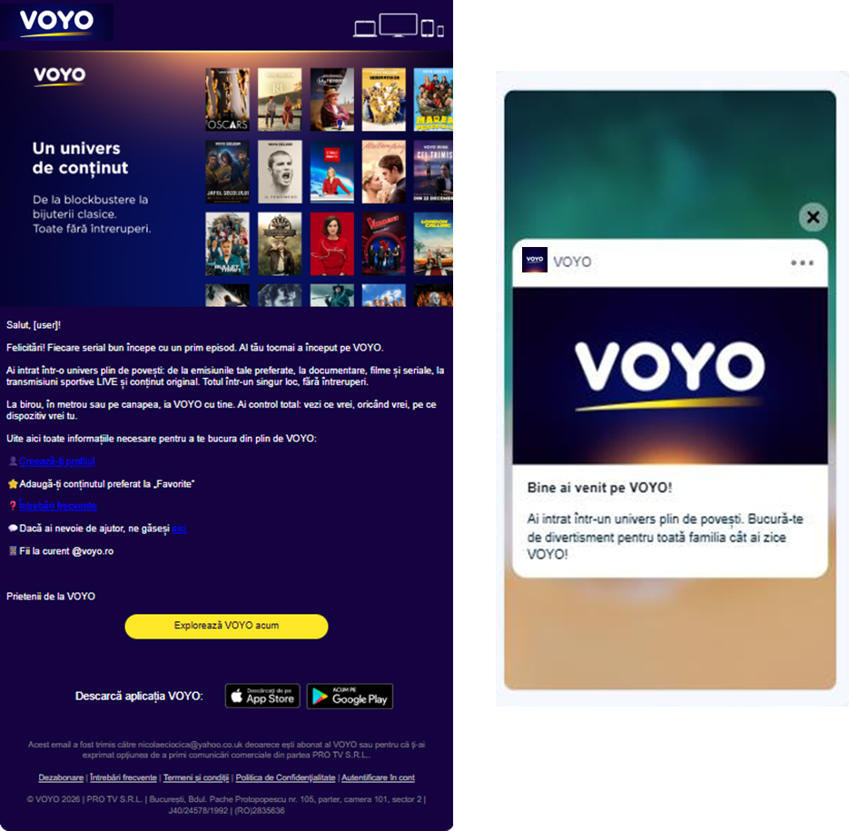
CRM & lifecycle communication
Templates & communication principles
Communication principles
The newsletter layout should only use the horizon primary gradient palette.
The branding must be present in all CRM communication, and the logo should be included in all newsletters.
The tone of voice should be consistent and personalized to each user.
The Newsletters should always include a visual illustration of the content.

Slide 3

CRM & lifecycle communication
Templates & communication principles
Welcome email template
Congratulations, [user]!
Every great series starts with a first episode and yours has just begun on VOYO.
You've stepped into a universe full of stories: from your favorite shows to documentaries, movies and series, live sports broadcasts, and original content. All in one place, with no interruptions.
Whether you're at the office, on the subway, or relaxing on the couch, take VOYO with you. You’re in full control: watch what you want, when you want, on any device you choose.
Here’s everything you need to make the most of VOYO:
👤 Create your profile
⭐ Add your favorite content to “Favorites”
❓ Frequently Asked Questions
💬 Need help? You can find us here
📢 Stay up to date @voyo.ro
[Explore VOYO now]
Your friends at VOYO

Slide 4
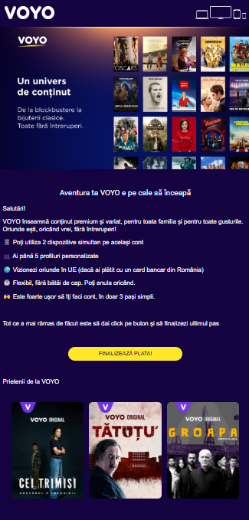

CRM & lifecycle communication
Templates & communication principles
Finish registration email template
Your VOYO adventure is about to begin
Hello, [user]!
VOYO means premium, diverse content for the whole family and for every taste.
Wherever you are, whenever you want, with no interruptions!
📱 You can use 2 devices at the same time on the same account
👥 You get up to 5 personalized profiles
🌍 Watch anywhere in the EU (if you paid with a Romanian bank card)
🕐 Flexible, hassle-free. You can cancel anytime.
🙌 Creating your account is super easy, in just 3 simple steps.
All that’s left to do is click the button and complete the final step. Activate your subscription
[FINISH PAYMENT]
Your friends at VOYO

Slide 5
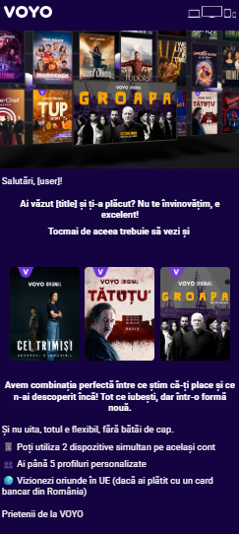
CRM & lifecycle communication
Templates & communication principles
Churn suspect email template
Hi, [user]!
Did you watch [title] and love it? We don’t blame you — it’s excellent!
That’s exactly why you should also check out
[recommendations]
We’ve got the perfect mix of what we know you like and what you haven’t discovered yet. Everything you love, with a whole new story.
And don’t forget, it’s all flexible and hassle-free.
📱 You can use 2 devices at the same time on the same account
👥 You get up to 5 personalised profiles
🌍 Watch anywhere in the EU (if you paid with a Romanian bank card)
Your friends at VOYO

Slide 6

CRM & lifecycle communication
Templates & communication principles
Binge watch (weekend) email template
Hi, [user]!
Are you looking for stories that go great with popcorn and a super comfy blanket? We got you!
That’s why we curated especially for you:
[personalized recommendations]
Have a memorable weekend with VOYO!

Slide 7
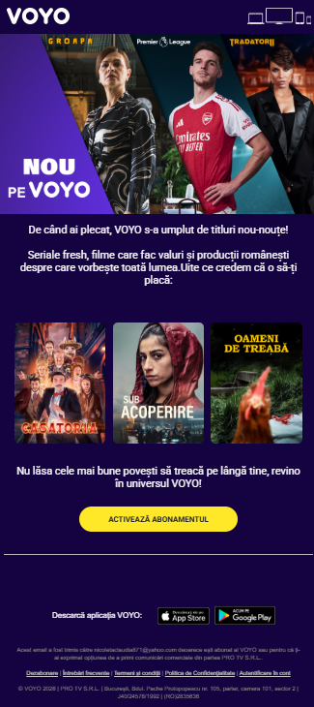
CRM & lifecycle communication
Templates & communication principles
Win-back email template
Since you’ve left, we added plenty of brand-new titles for you!
Come back and discover fresh series, trending movies and Romanian Original production that are the talk of the country! Here’s what we believe you’ll love:
[personalised recommendations]
Don’t miss the best stories, come back into your VOYO Universe!
[Re-activate your subscription]
Your friends at VOYO

